Slide 1
EZEKIEL

Slide 2
EZEKIEL
Ezekiel ~ God strengthens – chazaq + el
Contemporary of Daniel and Jeremiah
Jeremiah, Zechariah and Ezekiel were prophet/priests

Slide 3
EZEKIEL
1st Deportation 605 BC
3rd Deportation 586 BC
615 BC
585 BC
545 BC
515 BC
2nd Deportation 597 BC
Jeremiah ~ 626-586 BC
Daniel~ 603-533 BC
Ezekiel ~ 593-571 BC

Slide 4
EZEKIEL
1-24 = Judgment of Israel
25-32 = Judgment of nations
33-48 = Restoration

Slide 5
EZEKIEL
Lamentations “Wordle”

Slide 6
EZEKIEL
Reference | Eze. 1 | Is. 6 | Rev. 4
Identity
Faces
Wings
Speech
Eyes
Living Creatures
Living Creatures
Seraphim
4 different faces
4 each
N/A
4 wings
6 wings
4 wings
“Holy, holy, holy”
“Holy, holy, holy”
N/A
Within the rims
Covering the creatures
N/A

Slide 7
EZEKIEL
You shall know that I am the Lord ~ over 60x in Ezekiel

Slide 8
EZEKIEL
NIV ~ the chief prince of Meshach and Tubal

Slide 9
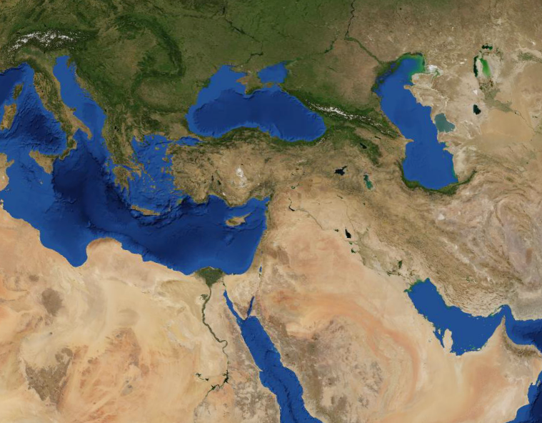
EZEKIEL
Magog
Russia
Georgia
Black Sea
Armenia
Gomer
Meschech
Caspian Sea
Turkey
Syria
Tubal
Togarmah
Lebanon
Rosh
Mediterranean Sea
Iran
Iraq
Persia
Jordan
Libya
Egypt
Persian Gulf
Red Sea
Ethiopia
Sudan

